Slide 1
Sem 12
Chain of responsibility
Command

Slide 2
CHAIN OF RESPONSABILITY
DP Comportamental

Slide 3
Chain of Responsibility – Principii generale
Definirea unui lant de responsabili ce pot trata un eveniment
Nivel de importanta atasat evenimentului -> o clasa particulara ce poate trata respectivul eveniment

Slide 4
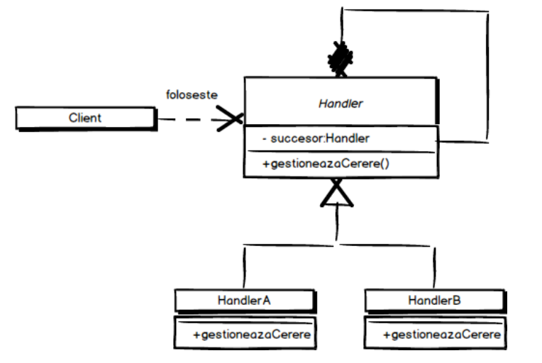
Chain of Responsibility – Diagrama

Slide 5
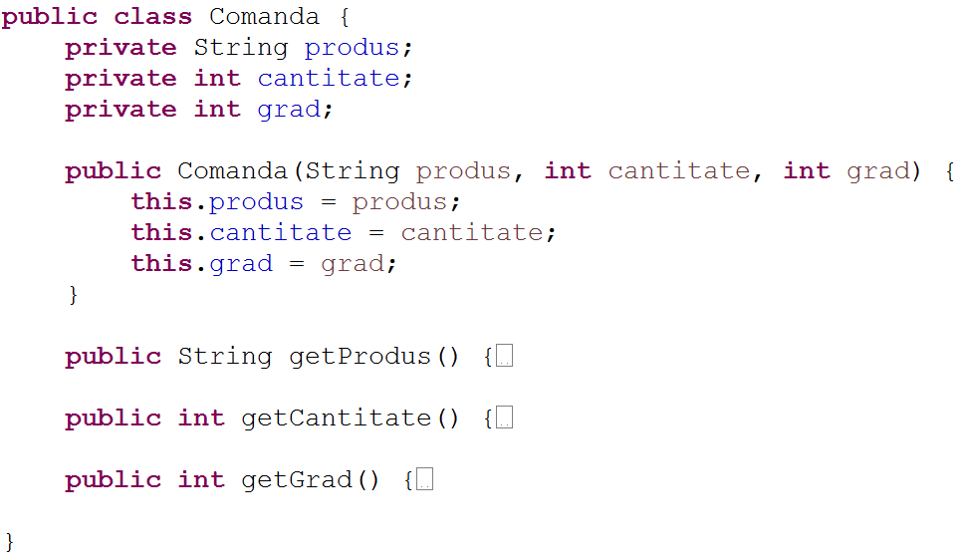
Chain of Responsibility – Exemplu

Slide 6
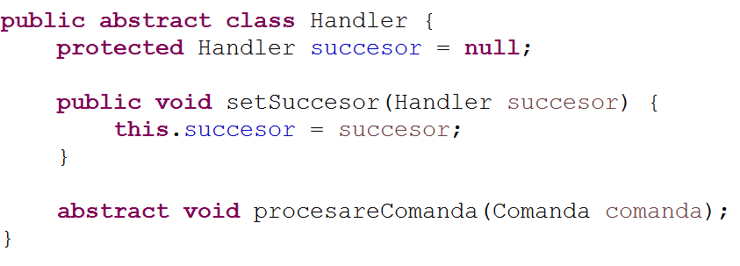
Chain of Responsibility – Exemplu

Slide 7
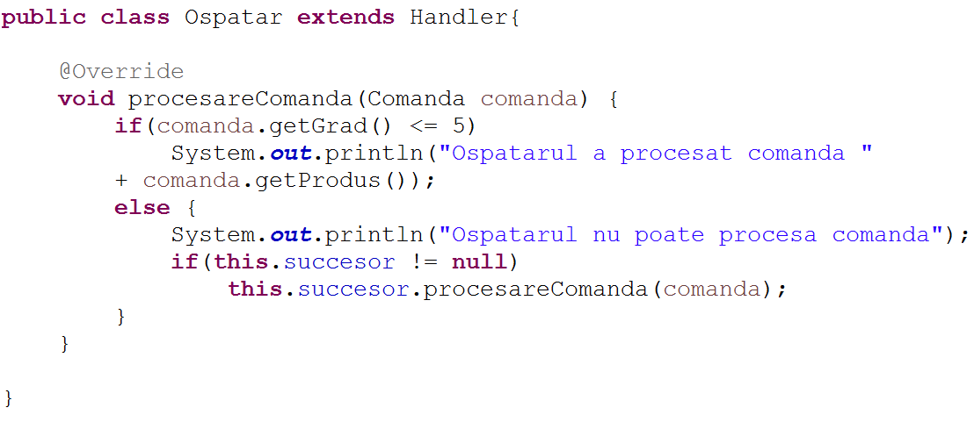
Chain of Responsibility – Exemplu

Slide 8
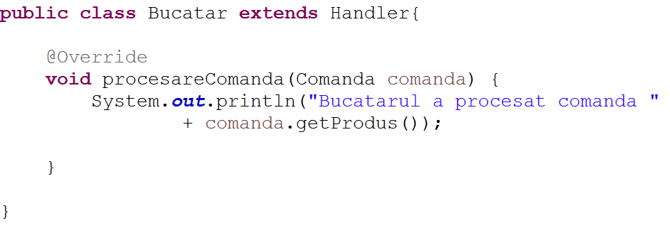
Chain of Responsibility – Exemplu

Slide 9
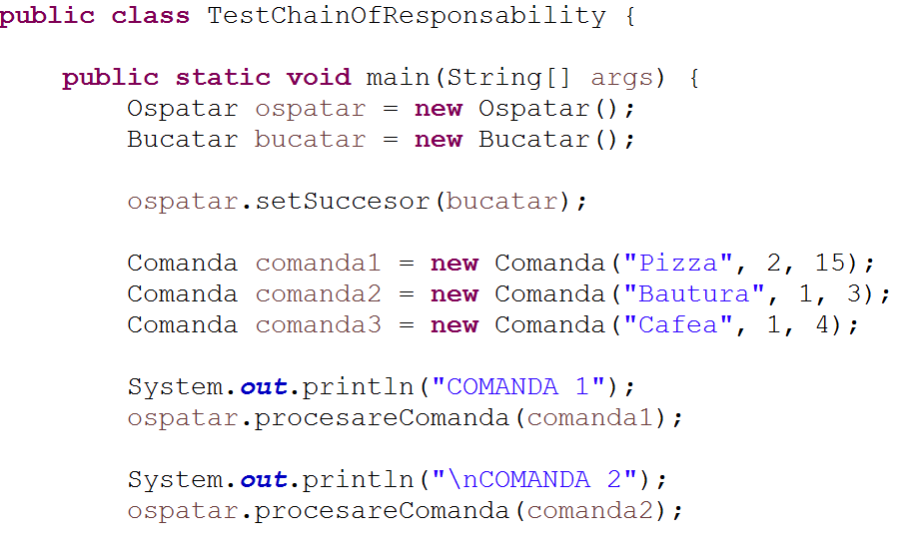
Chain of Responsibility – Testare

Slide 10
COMMAND
DP Comportamental

Slide 11
Command – Principii generale
Lista de actiuni/comenzi ce pot fi executate mai tarziu
Se decupleaza executia intarziata a unei actiuni de proprietar/declansator

Slide 12
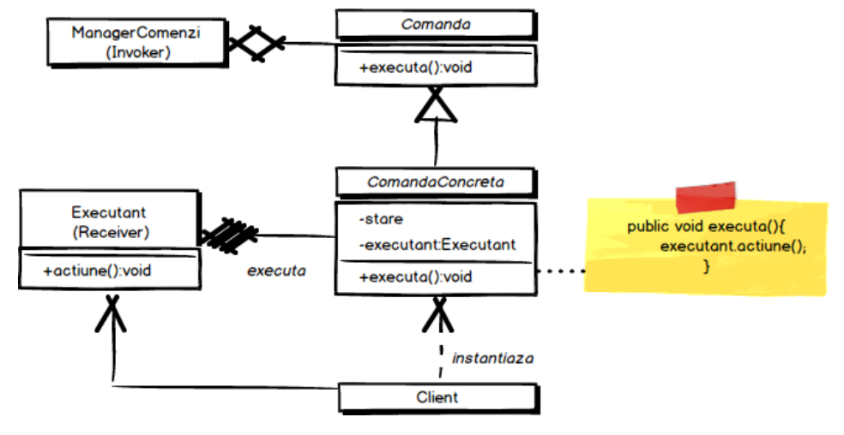
Command - Diagrama

Slide 13
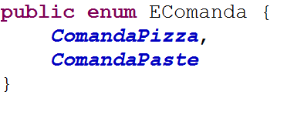
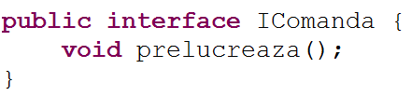
Command – Exemplu practic

Slide 14
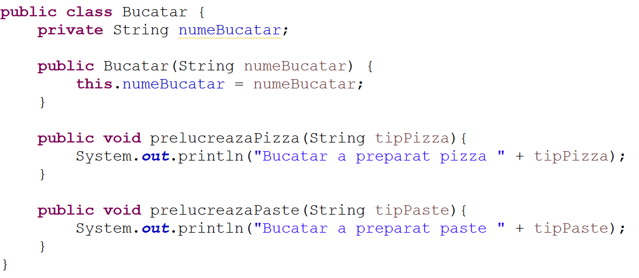
Command – Exemplu practic

Slide 15
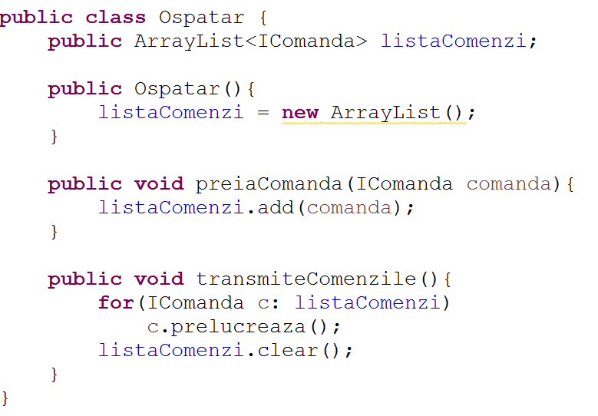
Command – Exemplu practic

Slide 16
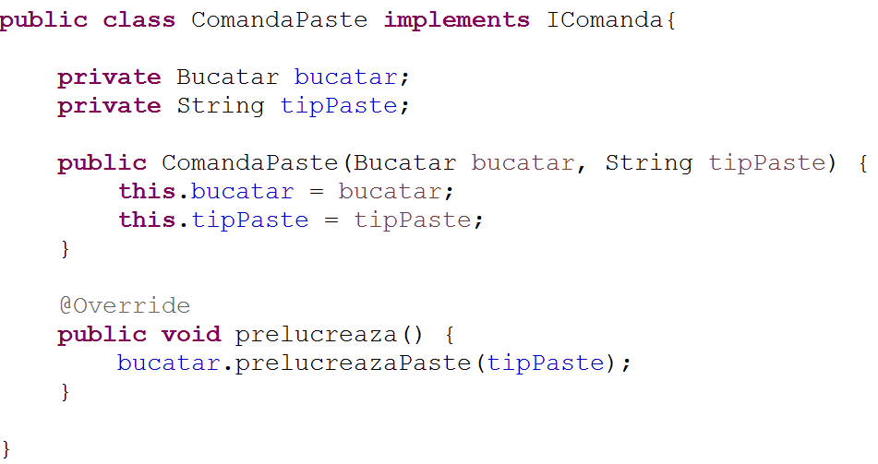
Command – Exemplu practic

Slide 17
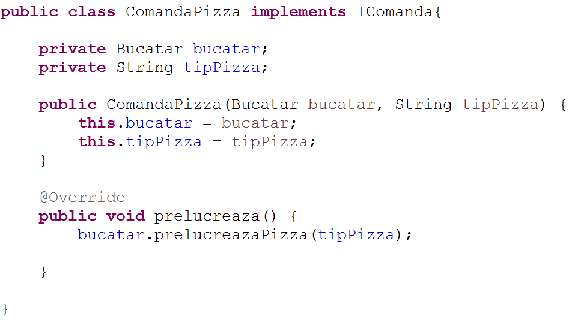
Command – Exemplu practic

Slide 18
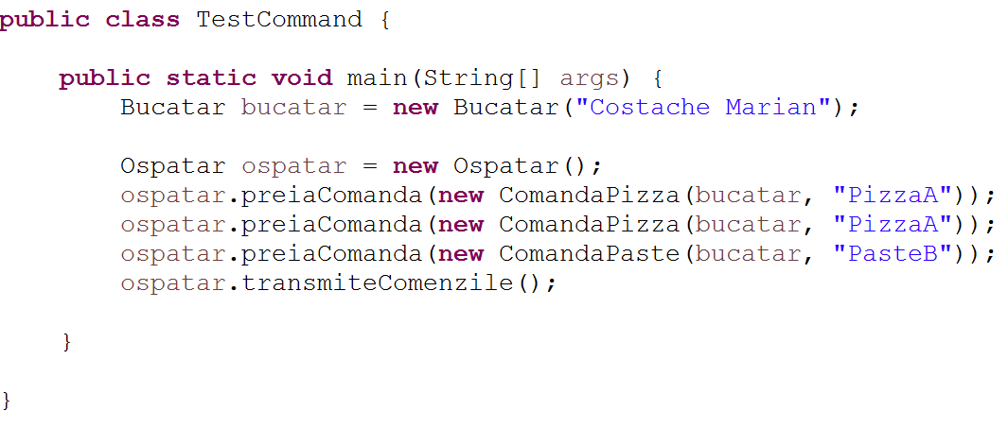
Command – Testare

